Slide 1
Implemented, not done and didn’t work (time limitation)
Implemented, done and worked
Implemented, done but didn’t work
Take road network from open street map
Download land cover map
Download highways
Extract road network for Oregon state
Extract road network in urban area exclude forest, agriculture, water
Exclude highways from road network (assuming side walks are not present in highways)
Buffer road
Extract road network in urban area exclude forest, agriculture, water
Calculate area

Slide 2
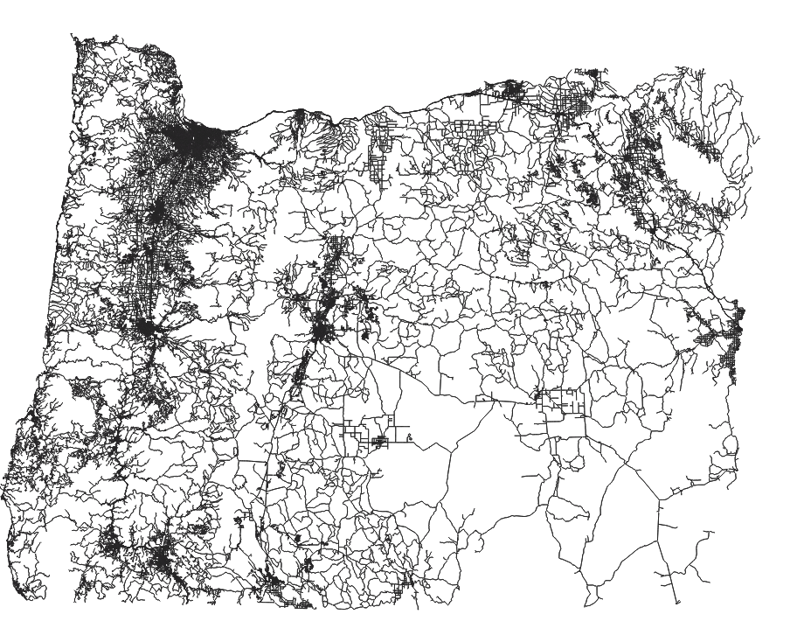
Road map downloaded from open street map

Slide 3
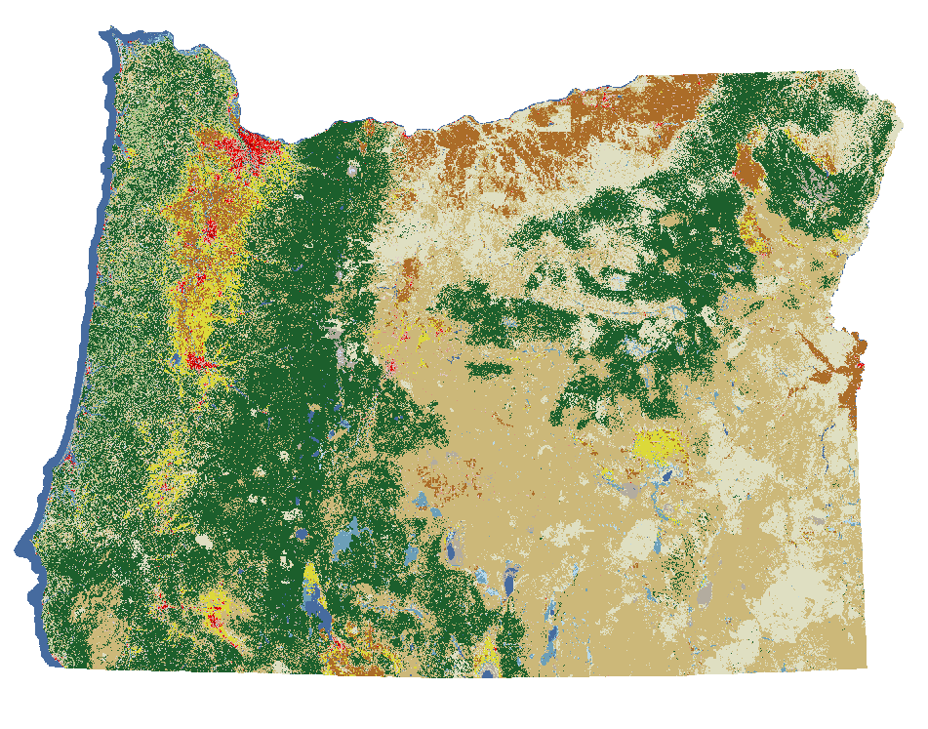
Land cover map of Oregon

Slide 4
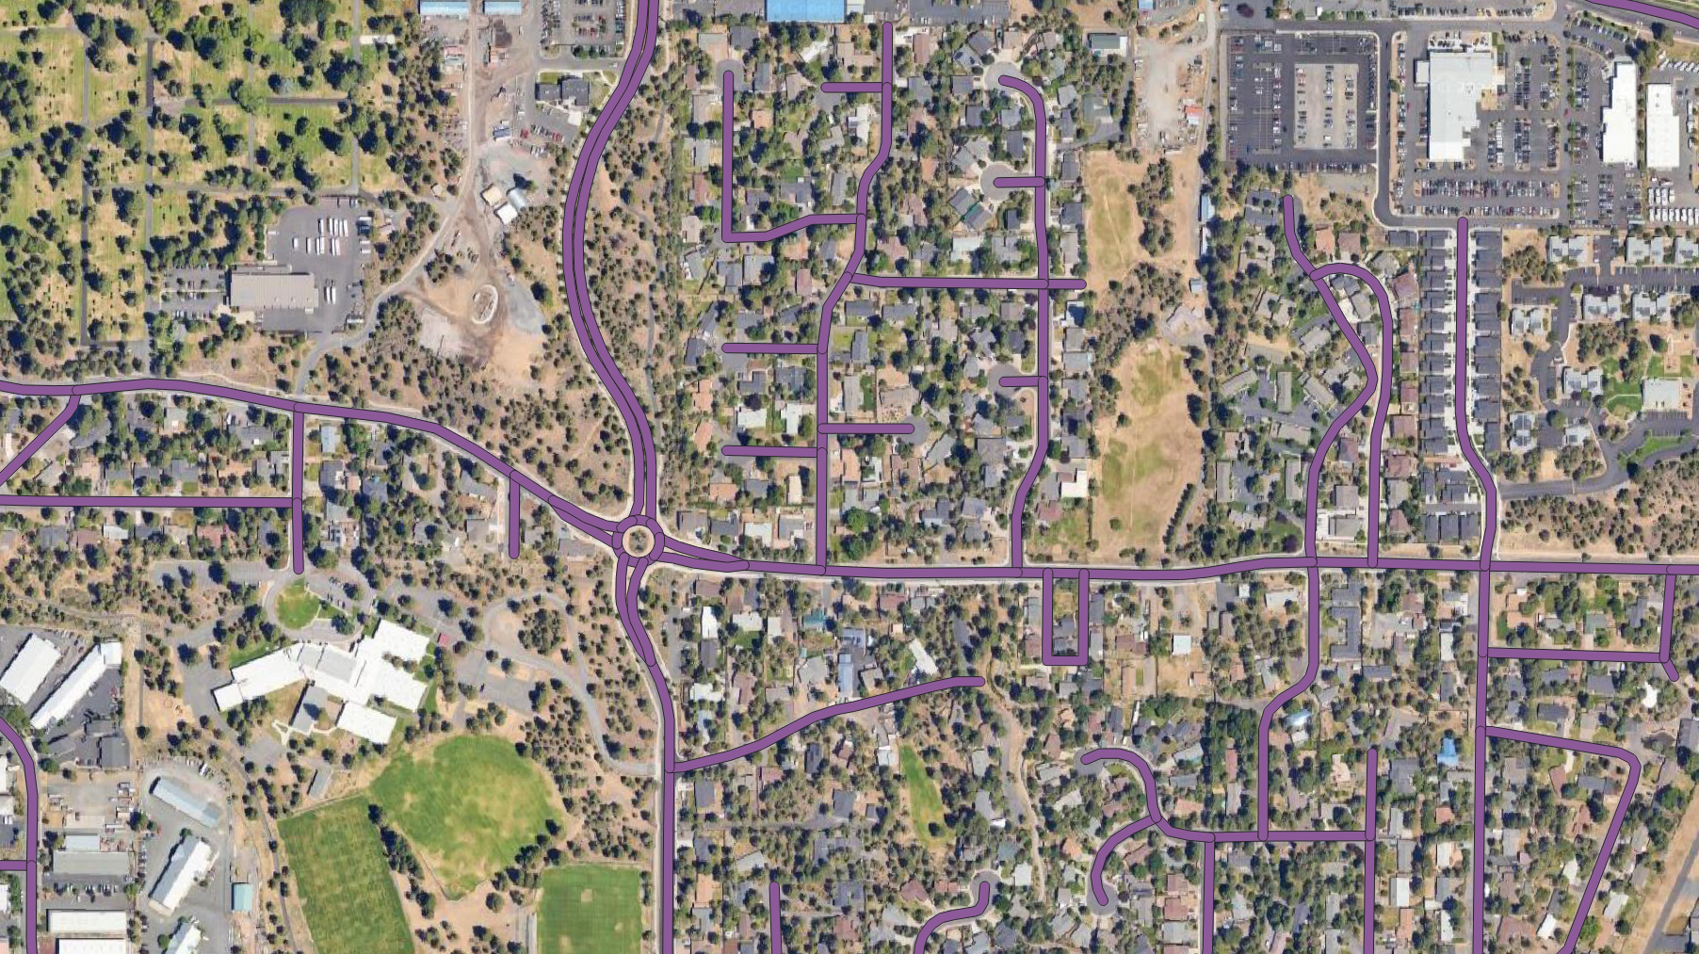
Buffered road map
Total area: 1764.40 sq km2 assuming 24 feet road width

Slide 5
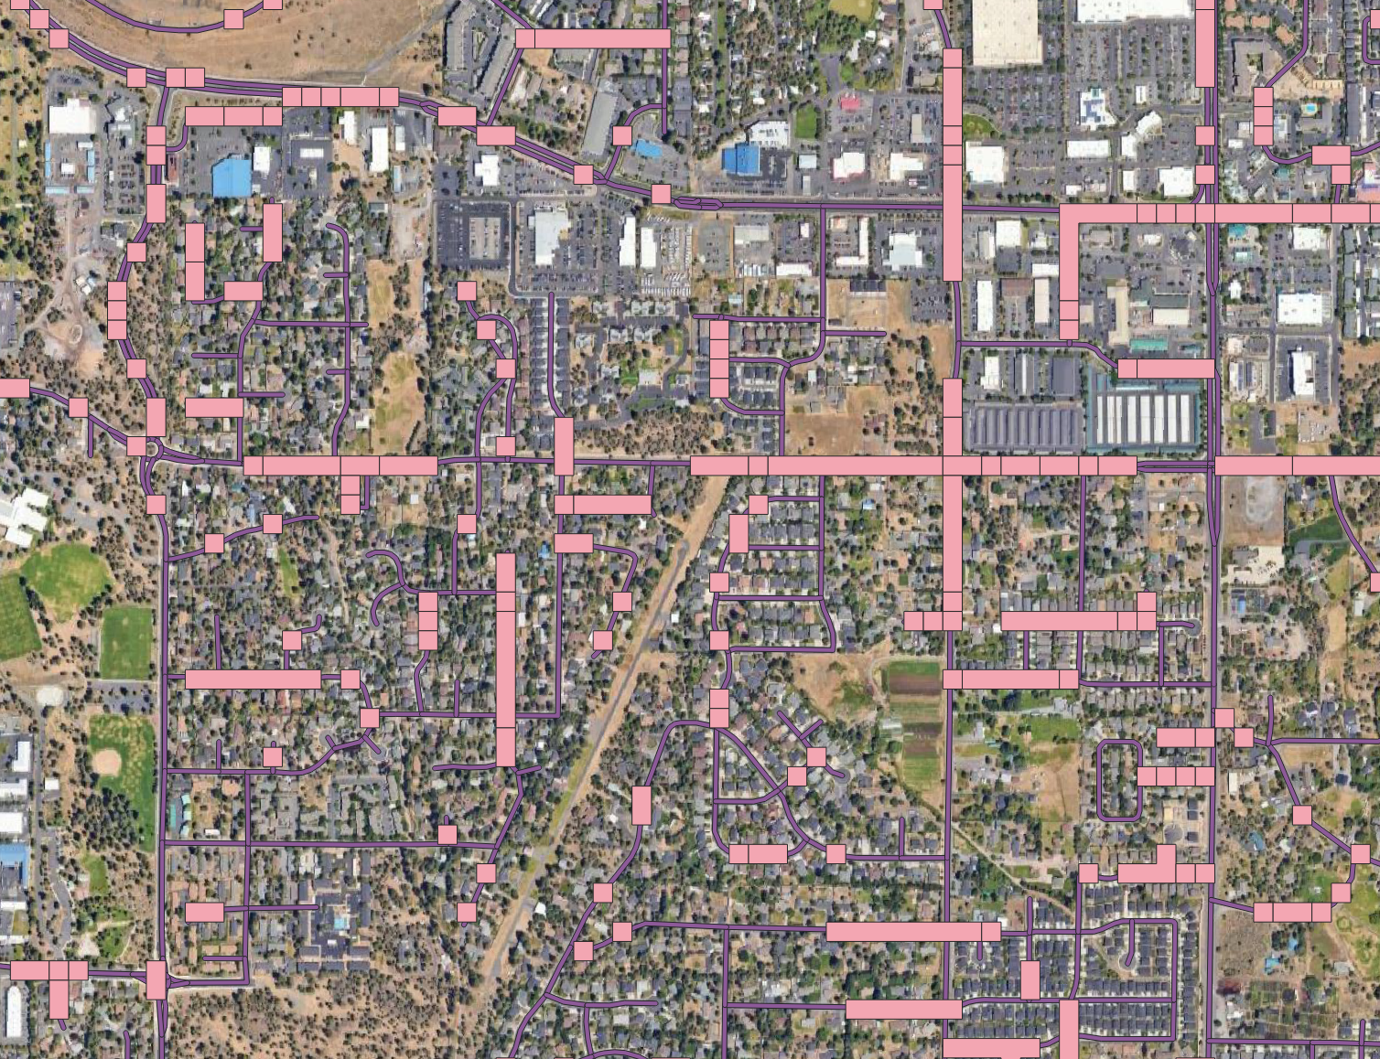
Intersection of buffered road network and land cover

Slide 6
Future improvements
Avoid highways and roads without sidewalks.
Use high-resolution or city zoning maps to narrow down the area further.
Apply the "road with sidewalk" filter from the OpenStreetMap (OSM) API:
Limitation: Not all sidewalks may appear in the search, leading to potential omissions.
Benefit: This data will still be valuable for training machine learning models.

